Slide 1
Vaccination Tracking System

Slide 2
Basic Details Of My Idea
Online Registration for Vaccination
Simple UI to understand easily for uneducated people also
Scheduling Appointment for Vaccination.
Name of vaccine available.
No of vaccines available .
Vaccines availability for different age groups.
Updating number of vaccines available.

Slide 3
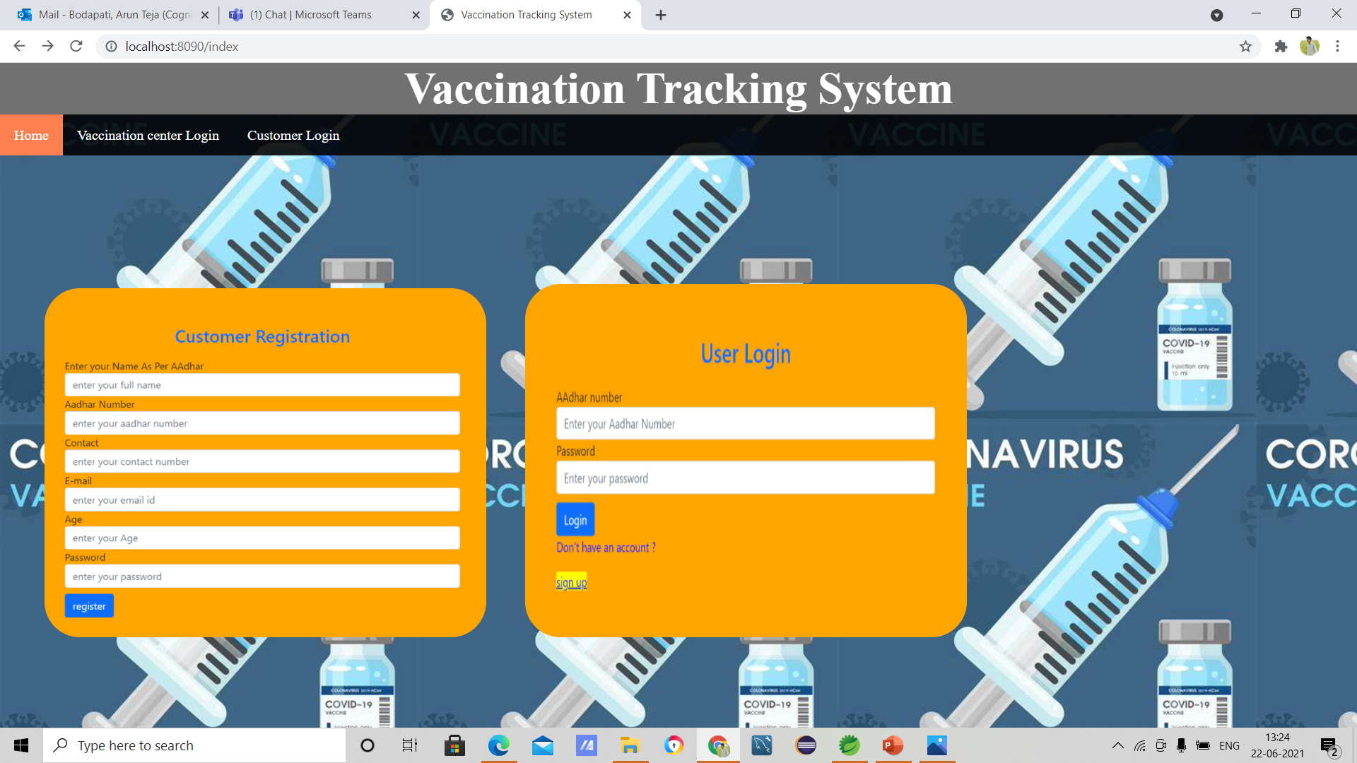
Home page

Slide 4
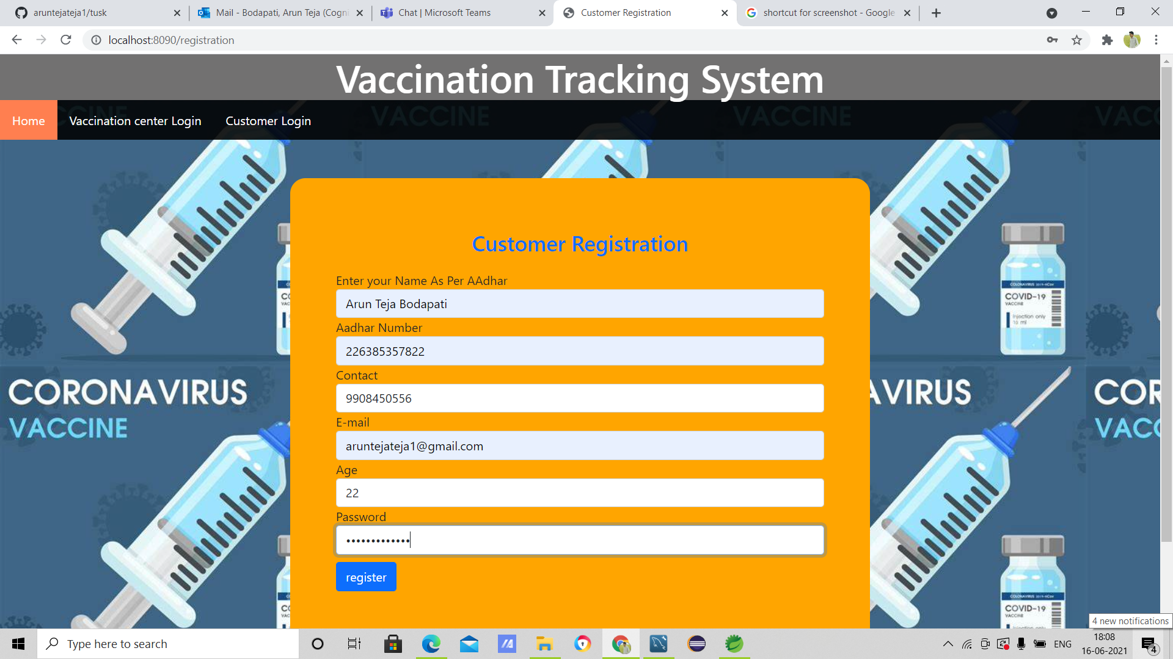
User Registration

Slide 5
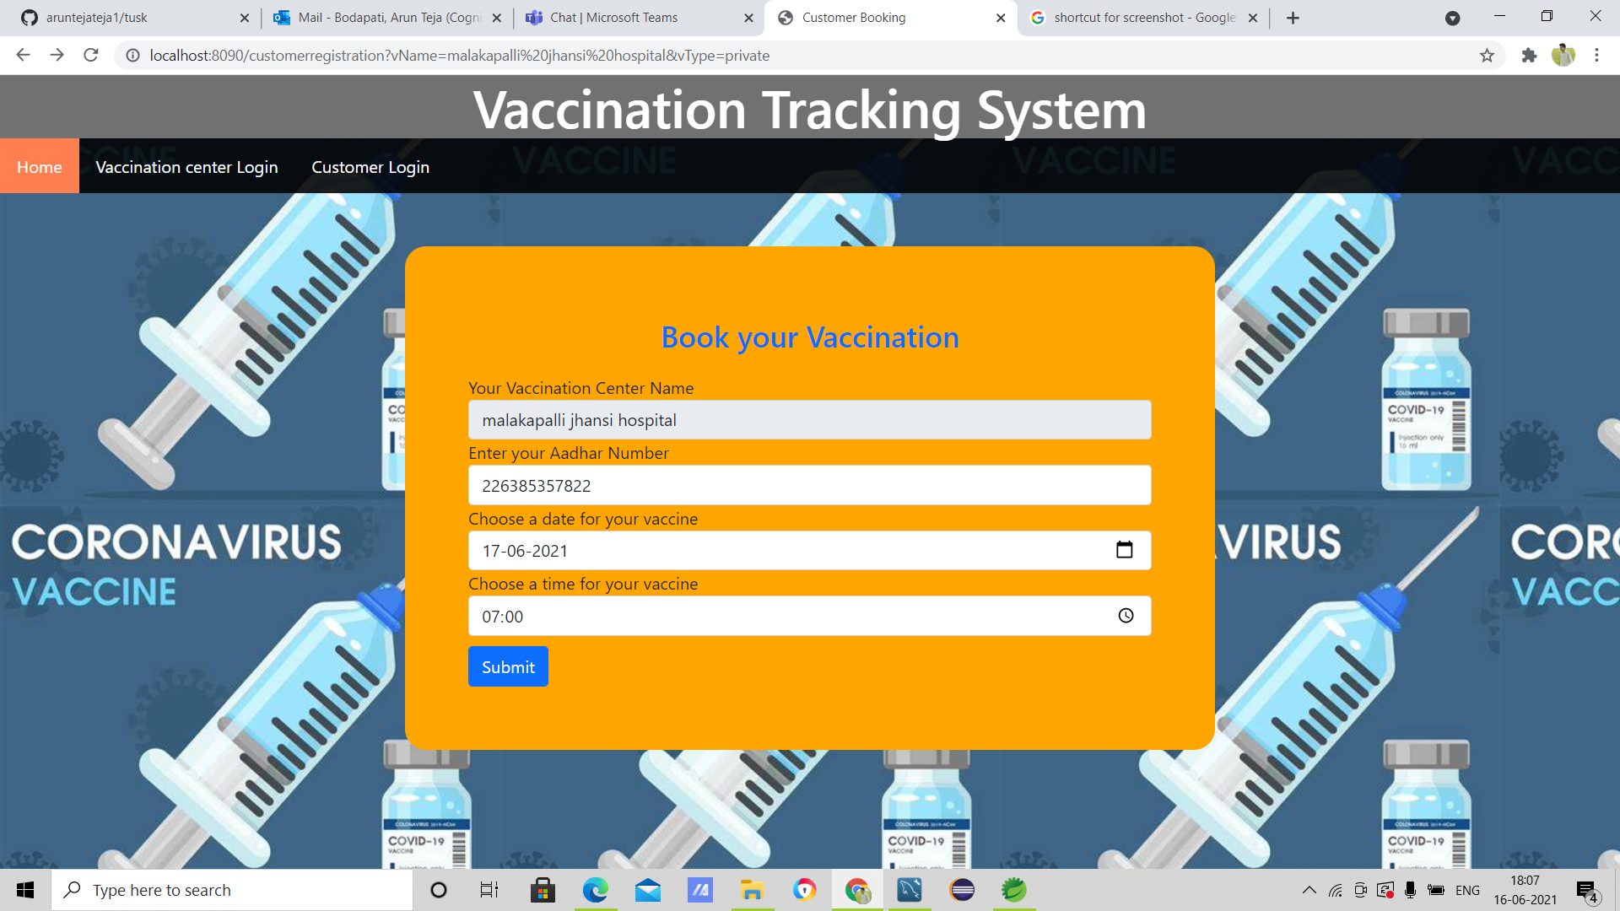
Book vaccination

Slide 6
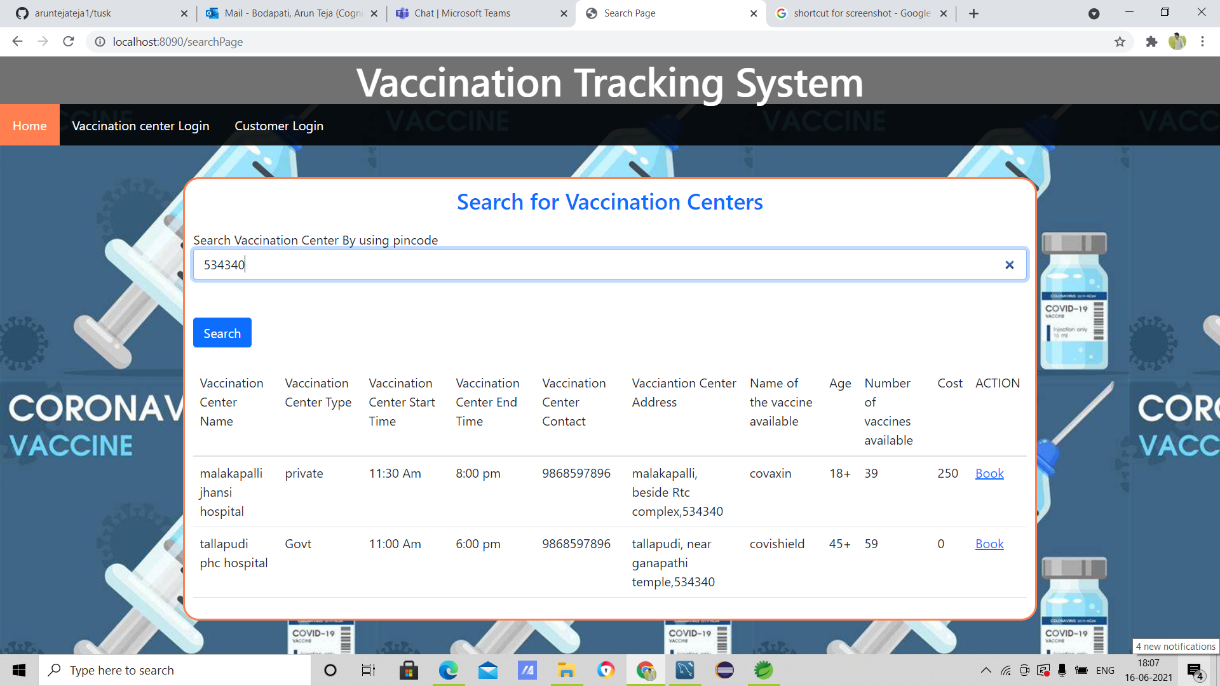
Search Page

Slide 7
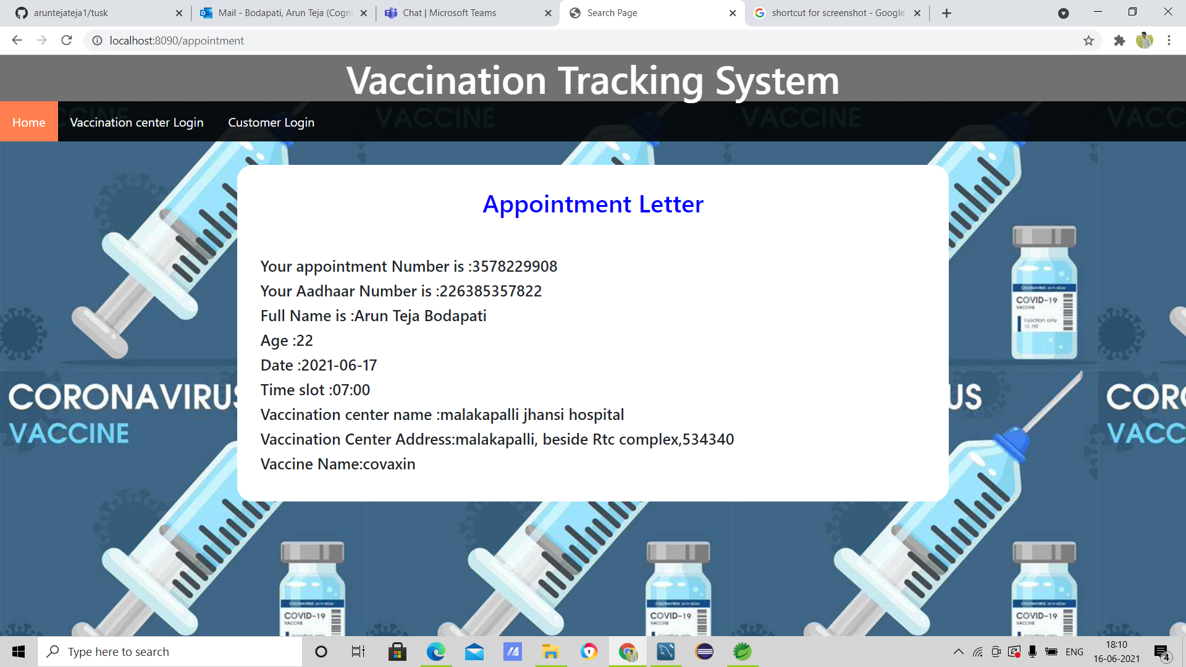
Appointment Letter

Slide 8
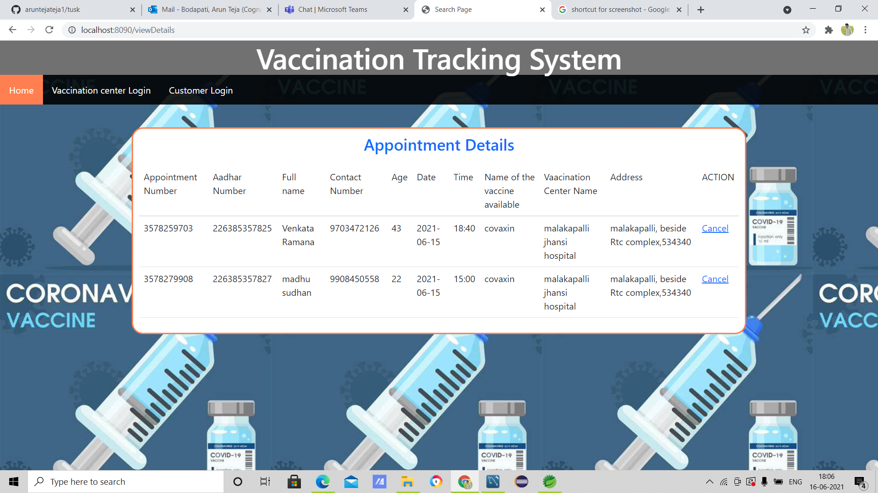
Appointment Details

Slide 9
Challenges faced while building prototype
Gap in technical Knowledge(Hibernate).

Slide 10
Thank You

